Slide 1
Comparative Analysis of Differentially Expressed Transcripts Identified from TCGA RNA-seq Data Compiled From Different Alignment/Normalization Methods
Suruchi Ahuja, Abbas Rizvi, Hoi Lam Tai, Jingchen Zhang
Group 2 Final Project
April 19, 2016

Slide 2
Outline
Introduction of RNA-seq
Project
Normalization Methods
Differential Expression Analysis
R Packages Used for Differential Analysis
Preliminary Results
Conclusions

Slide 3
Outline
Introduction of RNA-seq
Project
Normalization Methods
Differential Expression Analysis
R Packages Used for Differential Analysis
Preliminary Results
Conclusions

Slide 4
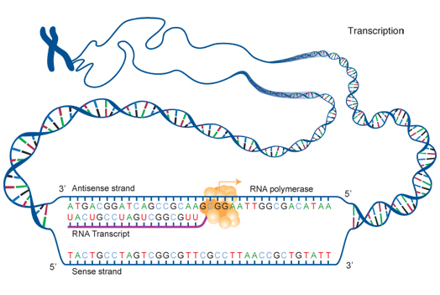
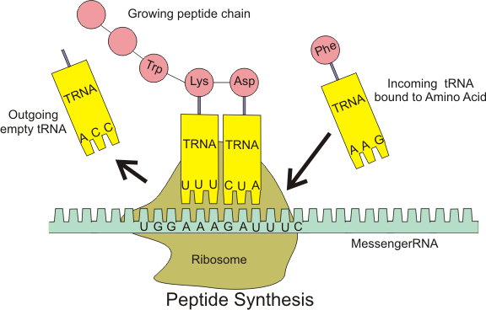
Central dogma of biology
DNA > mRNA > Polypeptide change> Protein

Slide 5
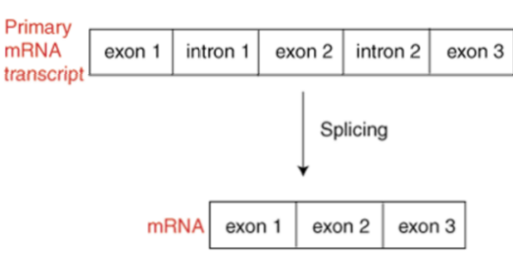
Concept of RNA splicing
Intron: Redundant sequencing(non-coding sequence)
Exon: Coding sequence to code for protein
Splicing:Removing all intron from primary mRNA transcript for translation

Slide 6
RNA Sequencing
Involves direct sequencing of complementary DNA (cDNA) using next generation sequencing (NGS) for discovering:
Transcript profiling and analysis of new transcripts
New isoforms
Alternative splice sites
Rare transcripts and cSNPs
(RNA-seqlopedia)
Notes:
followed by mapping of the sequencing reads to the reference genome or gene sets for gene expression analysis and polymorphism detection

Slide 7
Experimental Design: Annotation
GOAL: Characterize what is present rather than how much of it is present
Identify genes and genic architecture by analyzing short-sequencing reads derived form expression of RNA
*Very important that sequence reads evenly cover each transcripts, including both ends
Coverage is a function of the method used to prepare the library
Regardless of the method used to prepare the libraries, each method still results in uneven coverage of individual transcripts.
Deeper sequencing is required

Slide 8
Experimental Design: Differential Gene Expression
Quantitatively measure differences in level of transcripts between two or more treatment groups
Not as simple as comparing read counts that come from each transcript
Challenges:
No indication of how accurately such counts reflect what was actually present in original sample
Must obtain information on:
Sampling variance
Technical variance
Biological variance

Slide 9
RNA Preparation
1. Obtain RNA samples from normal people and tumor patients
2. Compare the RNA samples with their reference genome sequence
3. Data analysis

Slide 10
Library preparation
RNA converted into double-stranded cDNA
Sequence technologies require DNA template with platform-specific “adaptor” sequences at either end of each molecule
Generating the cDNA, adding the adaptors, and amplifying the DNA for sequencing round out the process of "library preparation".
Competing RNA-seq procedures diverge during library preparation, and the protocol details are highly dependent upon which strategy and sequencing platform is used.

Slide 11
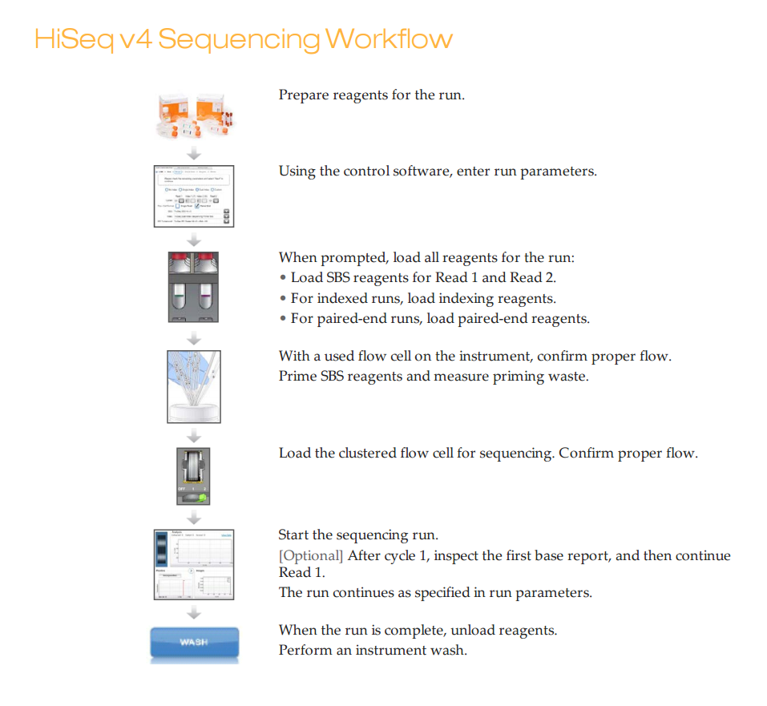
Sequencing
Technologies are rapidly expanding
Most commonly used platform: Illumina HiSeq 2500
Enables deep sequencing
Provides long enough, low-read errors that are suitable for mapping to reference genomes and transcriptome assembly

Slide 12
Microarray vs. RNA seq
Eliminated noise:
RNA-seq delivers low background signal and mapped to unique regions of the genome. Microarray with cross-hybridization problem
Broader dynamic range:
With array hybridization technology, gene expression measurement is limited by background at the low end and signal saturation at the high end. RNA-Seq technology quantifies discrete, digital sequencing read counts, offering a broader dynamic range.
Unbiased detection of novel transcripts:
Unlike arrays, RNA-Seq technology does not require species- or transcript-specific probes. It can detect novel transcripts, gene fusions, single nucleotide variants.
Easier detection of rare and low-abundance transcripts:
Sequencing coverage depth(number of times the RNA has been sequenced )can easily be increased to detect rare transcripts, single transcripts per cell, or weakly expressed genes.

Slide 13
Analysis
Genome Medicine 2012
Notes:
The fundamental idea is pretty simple: short sequence reads obtained from an mRNA sample can be mapped (by sequence similarity) back to a catalog of gene or mRNA sequences, and the number of reads mapping to each molecule then acts as a proxy for that molecule’s expression level in the sample.
To generalize, however, embarking on an RNA-seq study usually requires initial filtering of sequencing reads, assembling those reads into transcripts or aligning them to reference sequences, annotating the putative transcripts, quantifying the number of reads per transcript, and statistical comparison of transcript abundance across samples or treatments.

Slide 14
Outline
Introduction of RNA-seq
Project
Normalization Methods
Differential Expression Analysis
R Packages Used for Differential Analysis
Preliminary Results
Conclusions

Slide 15
Objective: Comparative analysis of TCGA RSEM Level 3 Data with realigned TCGA data using Rsubread feature counts
Specific Aims:
Research different alignment methods used in RNA-seq and understand how count data are presented after alignment
Research statistical assumptions of RNA-seq data and how they are modeled to detect differential expression
Conduct comparative analysis of statistically significant differentially expressed transcripts between TCGA RSEM Level 3 data and TCGA feature counts aligned by Rahman et al., 2015

Slide 16
The Cancer Genome Atlas (TCGA)
NIH and NHGRI funded project
Consortium of data on over 9,000 patients across 24+ cancer types
Clinical Data
Images
Microsatellite instability (MSI)
DNA-seq, miRNA-seq, RNA-seq, DNA methylation, protein expression
Different data types

Slide 17
TCGA RNA-seq Datasets
Two analysis pipelines used to create Level 3 expression data from RNA Sequence data (V2):
RPKM method*
MapSlice alignment and RSEM to perform quantitation
Rahman et al., 2015 – GSE62944
Rsubread version 1.14.2 R package
aligned the FASTQ files downloaded from Cancer Genomics Hub.
reads were aligned with align() function to the UCSC hg19 reference genome
featureCounts() function was used to summarize the gene level expression values as integer number
We subsetted both of these datasets to just the Primary Prostate Adenocarcinoma Cancer Subtype (52 Matched Normal-Tumor Patients)

Slide 18
Outline
Introduction of RNA-seq
Project
Normalization Methods
Differential Expression Analysis
R Packages Used for Differential Analysis
Preliminary Results
Conclusions

Slide 19
• Why normalization?
Ensure that technical bias has minimal impact on the results.
• Within Sample Normalization:
Normalize for each array separately.
• Between Sample Normalization:
Also called individual channel or separate channel normalization methods.
Normalize intensities or log-ratios to be comparable across arrays/experiments.

Slide 20
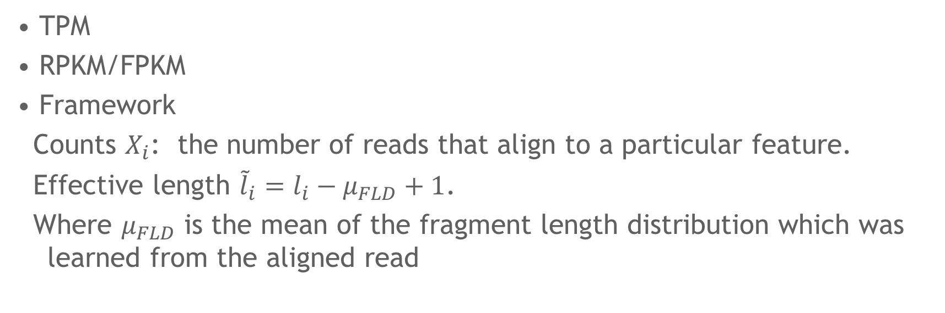
Within Sample Normalization
• TPM
• RPKM/FPKM
• Framework
Counts $X_{i}$: the number of reads that align to a particular feature.
Effective length ${\tilde{l}}_{i}=l_{i}−μ_{FLD}+1$.
Where $μ_{FLD}$ is the mean of the fragment length distribution which was learned from the aligned read

Slide 21
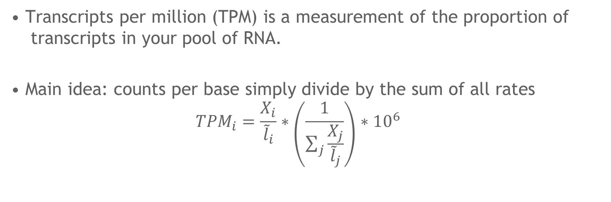
TPM
• Transcripts per million (TPM) is a measurement of the proportion of transcripts in your pool of RNA.
• Main idea: counts per base simply divide by the sum of all rates
$${TPM}_{i}=\frac{X_{i}}{{\tilde{l}}_{i}}∗\left(\frac{1}{\sum_{j}{\frac{X_{j}}{{\tilde{l}}_{j}}}}\right)∗{10}^{6}$$

Slide 22
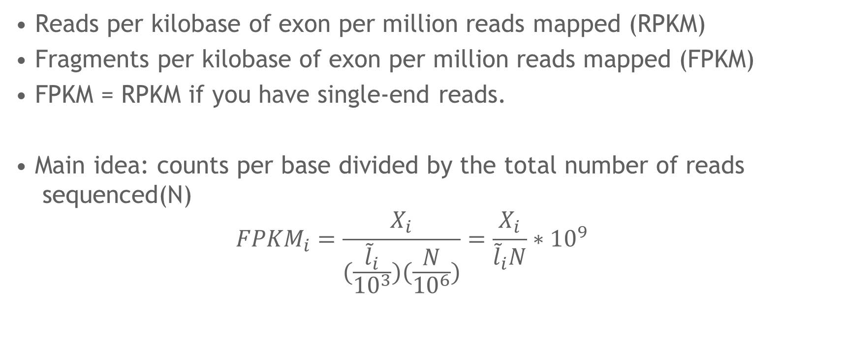
RPKM/FPKM
• Reads per kilobase of exon per million reads mapped (RPKM)
• Fragments per kilobase of exon per million reads mapped (FPKM)
• FPKM = RPKM if you have single-end reads.
• Main idea: counts per base divided by the total number of reads sequenced(N)
$${FPKM}_{i}=\frac{X_{i}}{(\frac{{\tilde{l}}_{i}}{{10}^{3}})(\frac{N}{{10}^{6}})}=\frac{X_{i}}{{\tilde{l}}_{i}N}∗{10}^{9}$$

Slide 23
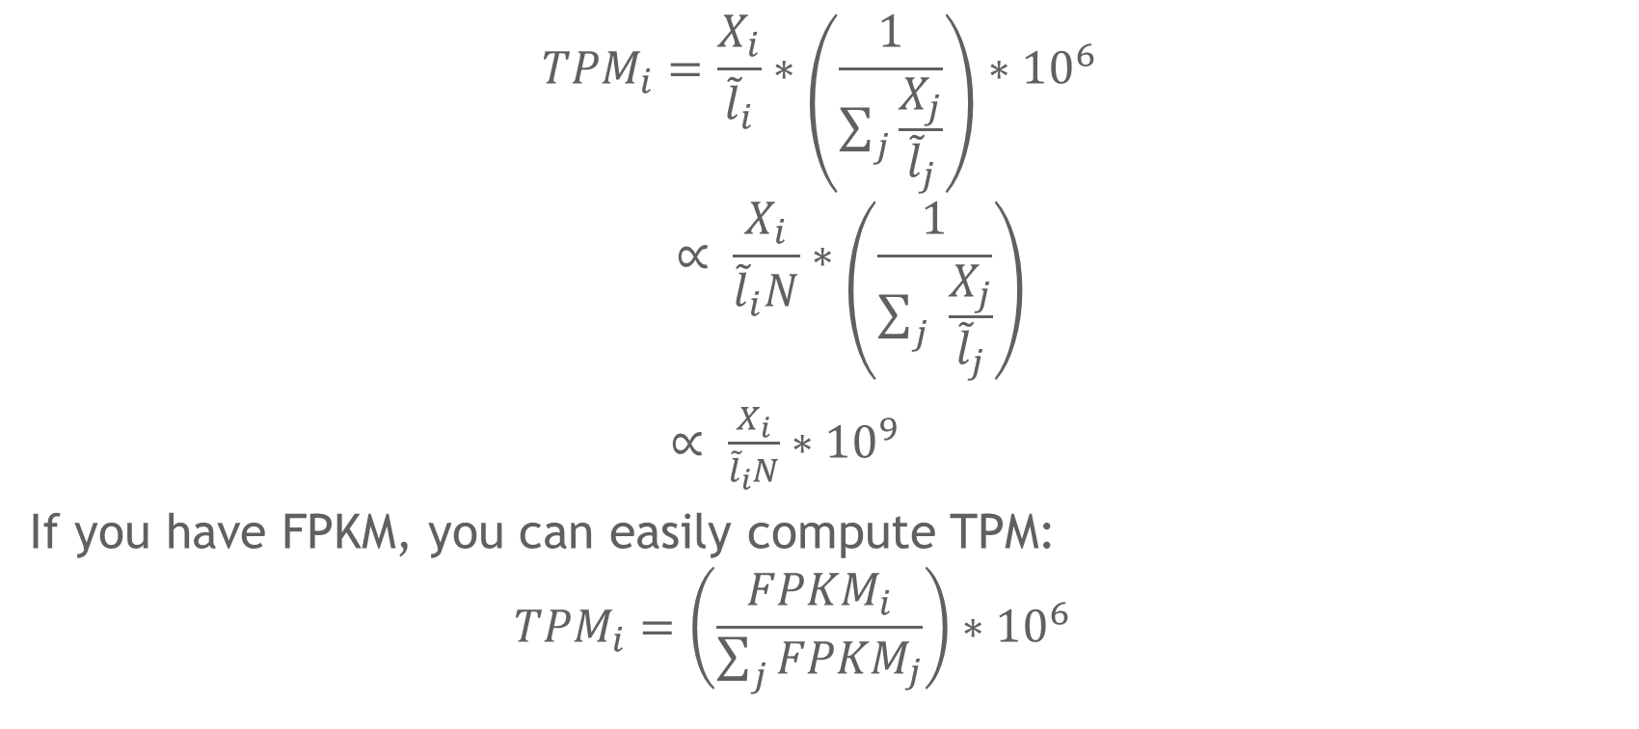
Relationship between TPM and FPKM
$${TPM}_{i}=\frac{X_{i}}{{\tilde{l}}_{i}}∗\left(\frac{1}{\sum_{j}{\frac{X_{j}}{{\tilde{l}}_{j}}}}\right)∗{10}^{6}$$
$$∝ \frac{X_{i}}{{\tilde{l}}_{i}N}∗\left(\frac{1}{\sum_{j}{ \frac{X_{j}}{{\tilde{l}}_{j}}}}\right)$$
$∝ \frac{X_{i}}{{\tilde{l}}_{i}N}∗{10}^{9}$
If you have FPKM, you can easily compute TPM:
$${TPM}_{i}=\left(\frac{{FPKM}_{i}}{\sum_{j}{{FPKM}_{j}}}\right)∗{10}^{6}$$

Slide 24
Between Sample Normalization
Two issues:
Variable sequencing depth (the total number of reads sequenced) between experiments.
Finding a “control set” of expression features which should have relatively similar expression patterns across experiments (e.g. genes that are not differentially expressed) to serve as a baseline.
Among the most popular and well-accepted BSN methods are TMM and DESeq normalization.

Slide 25
RSEM (RNA-Seq by Expectation-Maximization)
• An RNA-Seq transcript quantification program.
• For estimating gene and isoform expression levels from RNA-Seq data.

Slide 26
Why estimate the expression value before DE?
• The origin of some reads cannot always be uniquely determined.
• If two or more distinct transcripts in a particular sample share some common sequence, then sequence alignment may not be sufficient to discriminate the true origin of reads mapping to these transcripts.
[https://biowize.wordpress.com/2014/03/04/understanding-rsem-raw-read-counts-vs-expected-counts/]

Slide 27
Calculating Expression Values
• By default, RSEM automates the alignment of reads to reference transcripts using the Bowtie aligner.
• Utilize an Expectation-Maximization (EM) algorithm to estimate maximum likelihood expression levels
• These “expected counts” can then be provided as a matrix (rows = mRNAs, columns = samples) to programs such as EBSeq, DESeq, or edgeR to identify differentially expressed genes.

Slide 28
Differential Expression Analysis using EBSeq
• edgeR and DESeq do not take variance due to read mapping uncertainty into consideration.
• EBSeq, an empirical Bayesian DE analysis tool, can take variance due to read mapping ambiguity into consideration by grouping isoforms with p
• More robust to outliers. arent gene’s number of isoforms.

Slide 29
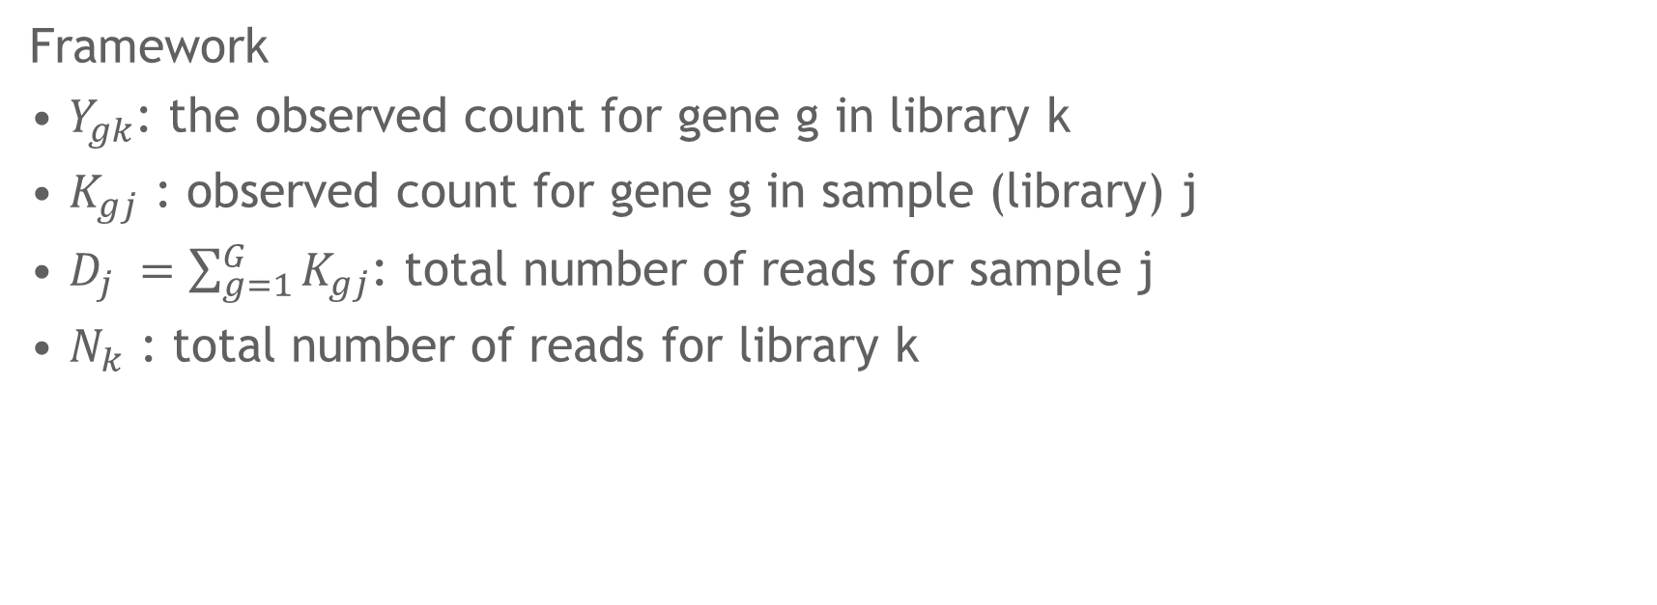
TMM
Framework
• $Y_{gk}$: the observed count for gene g in library k
• $K_{gj}$ : observed count for gene g in sample (library) j
• $D_{j} =\sum_{g=1}^{G}{K_{gj}}$: total number of reads for sample j
• $N_{k}$ : total number of reads for library k

Slide 30
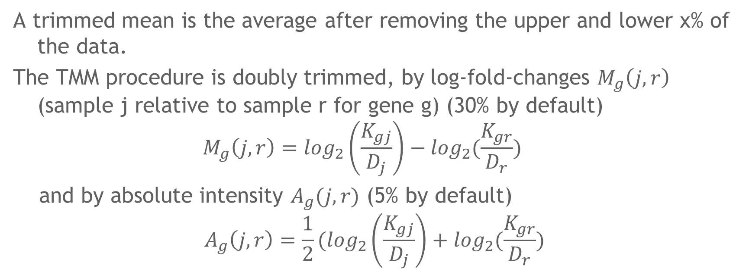
TMM
A trimmed mean is the average after removing the upper and lower x% of the data.
The TMM procedure is doubly trimmed, by log-fold-changes $M_{g}\left(j,r\right)$ (sample j relative to sample r for gene g) (30% by default)
$$M_{g}\left(j,r\right)=\log_{2}\left(\frac{K_{gj}}{D_{j}}\right)−\log_{2}(\frac{K_{gr}}{D_{r}})$$
and by absolute intensity $A_{g}(j,r)$ (5% by default)
$$A_{g}\left(j,r\right)=\frac{1}{2}(\log_{2}\left(\frac{K_{gj}}{D_{j}}\right)+\log_{2}(\frac{K_{gr}}{D_{r}})$$

Slide 31
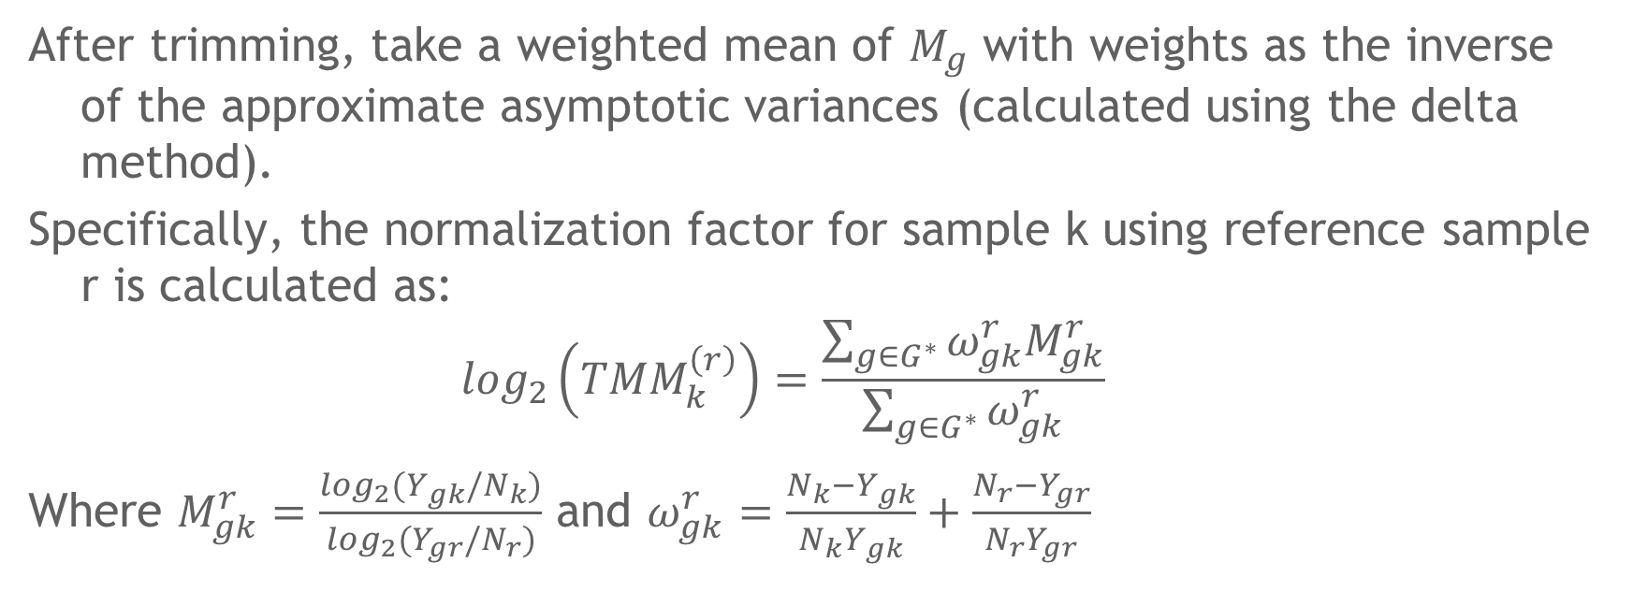
TMM
After trimming, take a weighted mean of $M_{g}$ with weights as the inverse of the approximate asymptotic variances (calculated using the delta method).
Specifically, the normalization factor for sample k using reference sample r is calculated as:
$$\log_{2}\left({TMM}_{k}^{\left(r\right)}\right)=\frac{\sum_{g∈G^{∗}}{ω_{gk}^{r}M_{gk}^{r}}}{\sum_{g∈G^{∗}}{ω_{gk}^{r}}}$$
Where $M_{gk}^{r}=\frac{\log_{2}(Y_{gk}/N_{k})}{\log_{2}(Y_{gr}/N_{r})}$ and $ω_{gk}^{r}=\frac{N_{k}−Y_{gk}}{N_{k}Y_{gk}}+\frac{N_{r}−Y_{gr}}{N_{r}Y_{gr}}$

Slide 32
Other Between Sample Normalization Methods
• DESeq normalization (relative log expression)
• Upper quantile normalization

Slide 33
Outline
Introduction of RNA-seq
Project
Normalization Methods
Differential Expression Analysis
R Packages Used for Differential Analysis
Preliminary Results
Conclusions

Slide 34
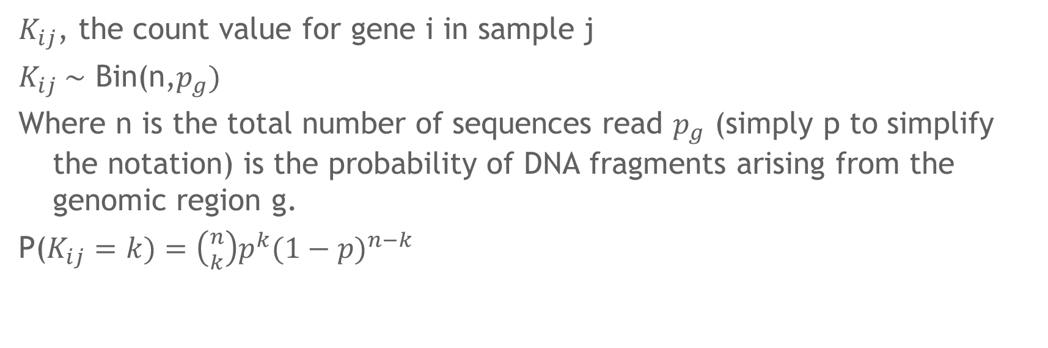
Binomial distribution and Poisson distribution
$K_{ij}$, the count value for gene i in sample j
$K_{ij} \sim$ Bin(n,$p_{g})$
Where n is the total number of sequences read $p_{g}$ (simply p to simplify the notation) is the probability of DNA fragments arising from the genomic region g.
P($K_{ij}=k)=\left({n \atop k}\right)p^{k}{(1−p)}^{n−k}$

Slide 35
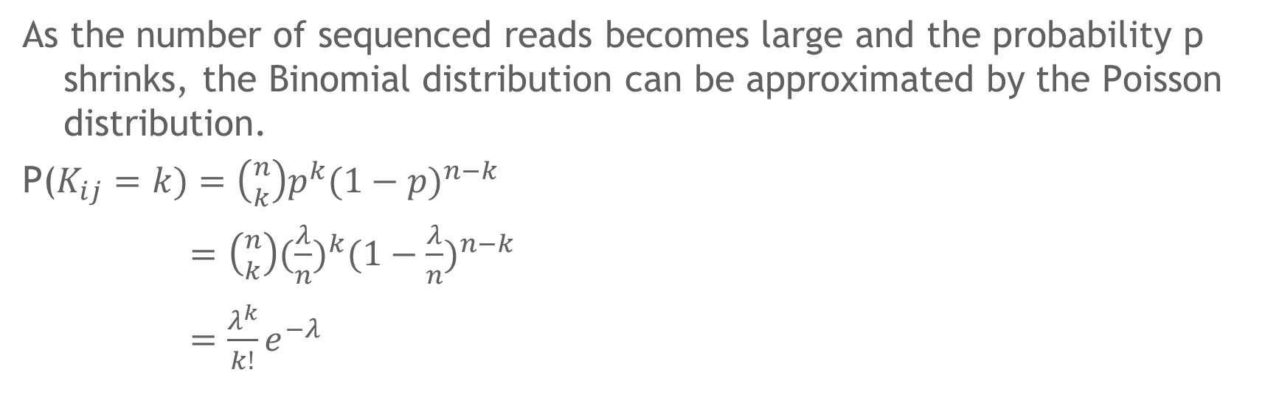
Binomial distribution and Poisson distribution
As the number of sequenced reads becomes large and the probability p shrinks, the Binomial distribution can be approximated by the Poisson distribution.
P($K_{ij}=k)=\left({n \atop k}\right)p^{k}{(1−p)}^{n−k}$
$=$ $\left({n \atop k}\right)({\frac{λ}{n})}^{k}{(1−\frac{λ}{n})}^{n−k}$
$=\frac{λ^{k}}{k!}e^{−λ}$

Slide 36
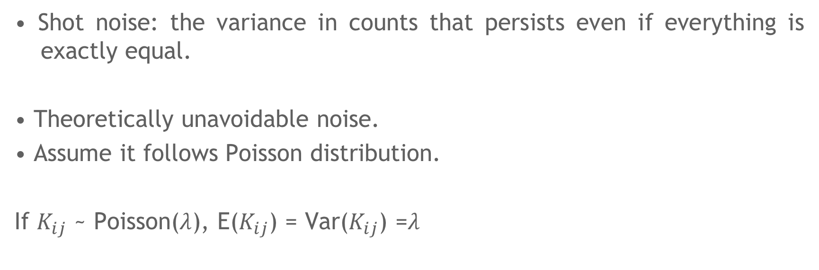
Shot noise
• Shot noise: the variance in counts that persists even if everything is exactly equal.
• Theoretically unavoidable noise.
• Assume it follows Poisson distribution.
If $K_{ij}$ ~ Poisson($λ$), E($K_{ij}$) = Var($K_{ij}$) =$λ$

Slide 37
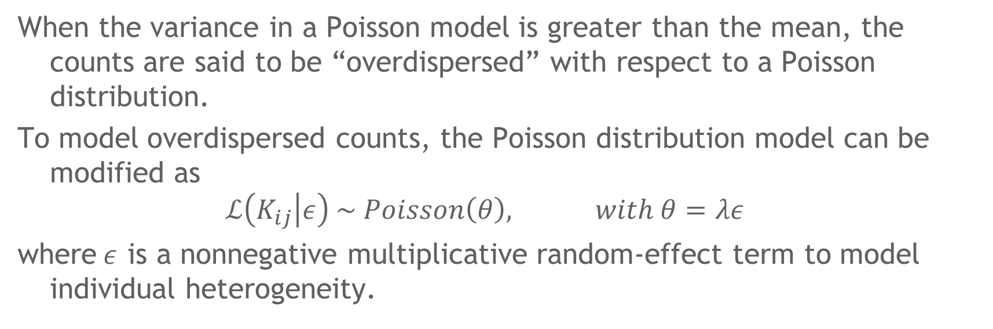
Biological noise: overdispersion
When the variance in a Poisson model is greater than the mean, the counts are said to be “overdispersed” with respect to a Poisson distribution.
To model overdispersed counts, the Poisson distribution model can be modified as
$$ℒ\left(K_{ij} | ε\right) \sim Poisson\left(θ\right), with θ=λε$$
where$ε$ is a nonnegative multiplicative random-effect term to model individual heterogeneity.

Slide 38
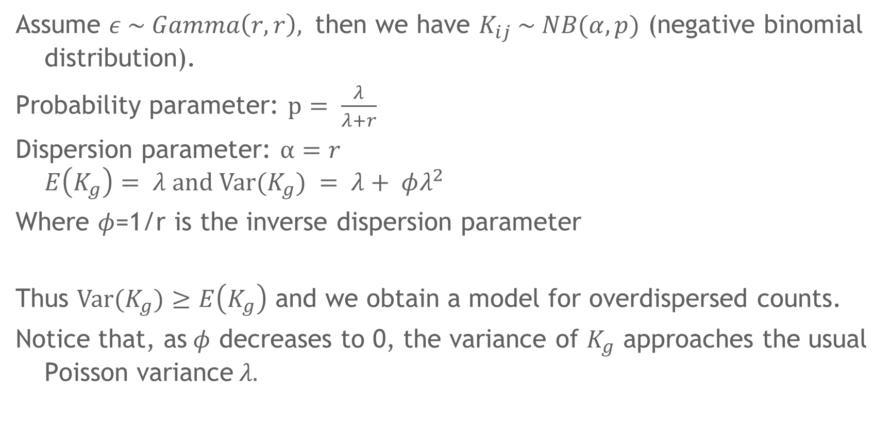
Assume $ε \sim Gamma\left(r, r\right),$ then we have $K_{ij} \sim NB(α,p)$ (negative binomial distribution).
Probability parameter: $p= \frac{λ}{λ+r}$
Dispersion parameter: $α=r$
$$E\left(K_{g}\right)= λ and Var(K_{g}) = λ+ φλ^{2}$$
Where $φ$=1/r is the inverse dispersion parameter
Thus $Var(K_{g})≥$ $E\left(K_{g}\right)$ and we obtain a model for overdispersed counts.
Notice that, as$φ$ decreases to 0, the variance of $K_{g}$ approaches the usual Poisson variance$λ.$

Slide 39
Outline
Introduction of RNA-seq
Project
Normalization Methods
Differential Expression Analysis
R Packages Used for Differential Analysis
Preliminary Results
Conclusions

Slide 40
limma
• The voom transformation is applied to the read counts. This converts the counts to log-counts per million with associated precision weights.
• The basic statistic used for significance analysis is the moderated t-statistic, which is computed for each probe and for each contrast. (the standard errors have been moderated across genes).
• Benjamini and Hochberg's method to control the false discovery rate.

Slide 41
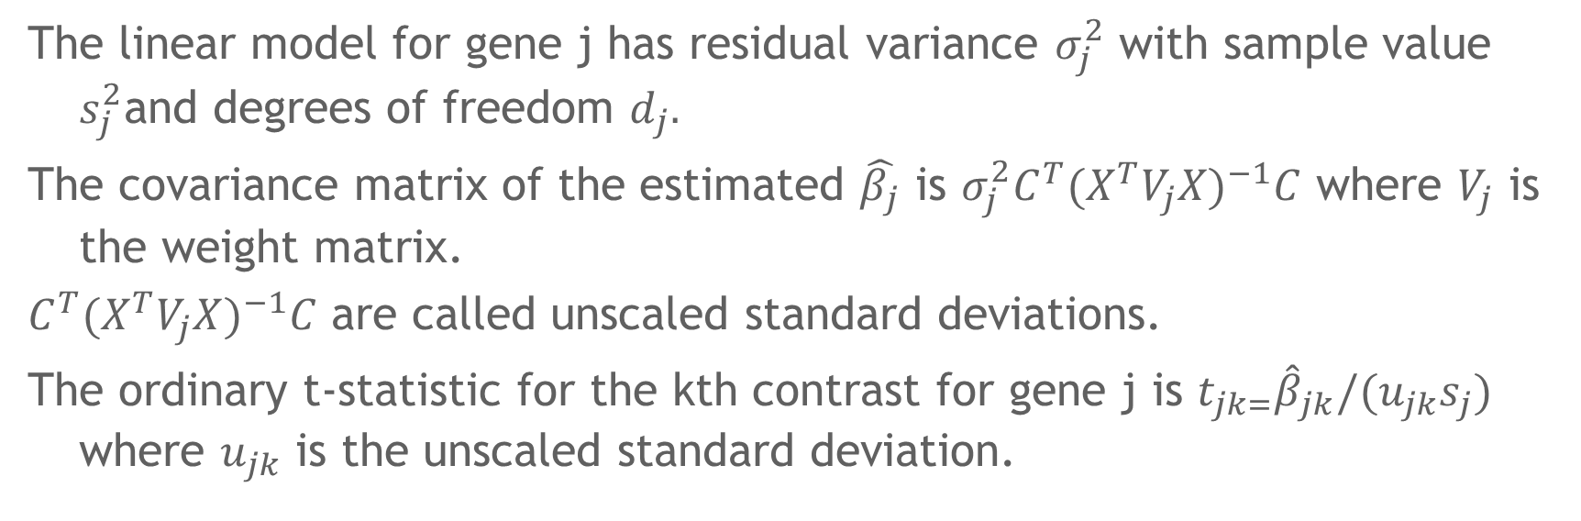
Linear Models
The linear model for gene j has residual variance $σ_{j}^{2}$ with sample value $s_{j}^{2}$and degrees of freedom $d_{j}.$
The covariance matrix of the estimated $\hat{β_{j}}$ is $σ_{j}^{2}{C^{T}(X^{T}V_{j}X)}^{−1}C$ where $V_{j}$ is the weight matrix.
${C^{T}(X^{T}V_{j}X)}^{−1}C$ are called unscaled standard deviations.
The ordinary t-statistic for the kth contrast for gene j is $t_{jk=}{\hat{β}}_{jk}/(u_{jk}s_{j})$ where $u_{jk}$ is the unscaled standard deviation.

Slide 42
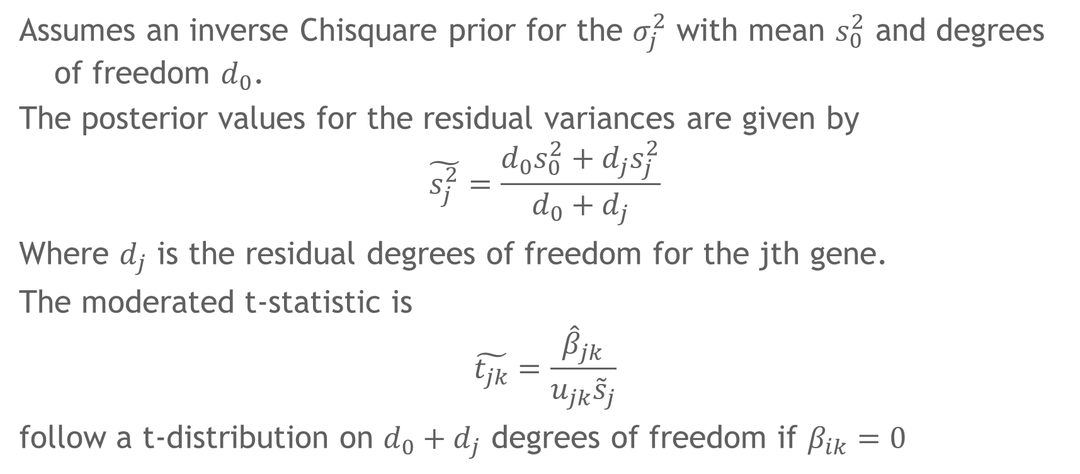
The empirical Bayes method
Assumes an inverse Chisquare prior for the $σ_{j}^{2}$ with mean $s_{0}^{2}$ and degrees of freedom $d_{0}$.
The posterior values for the residual variances are given by
$$\tilde{s_{j}^{2}}=\frac{d_{0}s_{0}^{2}+d_{j}s_{j}^{2}}{d_{0}+d_{j}}$$
Where $d_{j}$ is the residual degrees of freedom for the jth gene.
The moderated t-statistic is
$$\tilde{t_{jk}}=\frac{{\hat{β}}_{jk}}{u_{jk}{\tilde{s}}_{j}}$$
follow a t-distribution on $d_{0}+d_{j}$ degrees of freedom if $β_{ik}=0$

Slide 43
DESeq2
The package DESeq2 provides methods to test for differential expression by use of negative binomial generalized linear models; the estimates of dispersion and logarithmic fold changes incorporate data-driven prior distributions.
Here the input data must be the count data as obtained from RNA-seq or any sequencing experiment in the form of a matrix of integer values.
The DESeq2 model internally corrects for the library size, so transformed or normalized values such as counts scaled by library size should not be used as input.

Slide 44
Outline
Introduction of RNA-seq
Project
Normalization Methods
Differential Expression Analysis
R Packages Used for Differential Analysis
Preliminary Results
Conclusions

Slide 45
Exploratory Data Analysis
A
Mean vs. Variance Plot
B
rowMeans of Dataset

Slide 46
Exploratory Data Analysis
Normalized Row Means
Inverse hyperbolic
Sine transform
Log2 + pseudocount
Transform
Variance stabilizing
transform
voom
transform

Slide 47
Volcano Plots Visualizing Differential Expression
A
B
C
RPKM
Blue dots: abs(logFC) > 1.5, FDR < 0.05

Slide 48
Overlap of significant DEGs using different DE pipelines
A
B
C
Significant Differentially Expressed Transcripts:
abs(logFC) > 1.5, FDR < 0.05

Slide 49
Outline
Introduction of RNA-seq
Project
Normalization Methods
Differential Expression Analysis
R Packages Used for Differential Analysis
Preliminary Results
Conclusions

Slide 50
Interpretations/Thoughts
Different approaches to analyze differentially expressed genes, results in distinct outcomes.
The input differences between differential expression algorithms are often overlooked, yet they require an appropriate input for plausible results.
Does DESeq2 have a bias towards detecting longer genes as statistically significant?

Slide 51
Future Directions
Consider rounding RSEM to nearest whole integer and use DESeq2
Conduct analysis of both groups of datasets with edgeR
Conduct comparison of gene length against FDR-corrected pvalues from all analyses
Heat maps of DETs to observe patterns across patients
PCA of patients – look for batch effects (sva package)
GSEA of DETs for biological insight

Slide 52
Questions?

